Slide 1



Training Models Geared for Rapid Improvement Initiatives
Featuring:
Sheila Guidry, Louisiana Dept. of Education
Donald Fraynd, Chicago Public Schools
Randel Josserand, Chicago Public Schools

Slide 2
Poll Questions
#1: Using the polling tool, indicate if
Your state or local agency has a turnaround training program or model in place
Your state or local agency has plans to design a turnaround training program or model starting in SY2010-11
Your state or local agency does NOT have any immediate plans for a turnaround training program or model
Not Applicable (not a state or local agency)
# 2: Using the polling tool, indicate if you are a
Local state agency (i.e., school district)
State education agency
Regional comprehensive center, national content center or other technical assistance provider

Slide 3
Training Models Geared for Rapid Improvement Initiatives
Featuring:
Sheila Guidry, Louisiana Dept. of Education
Donald Fraynd, Chicago Public Schools
Randel Josserand, Chicago Public Schools

Slide 4
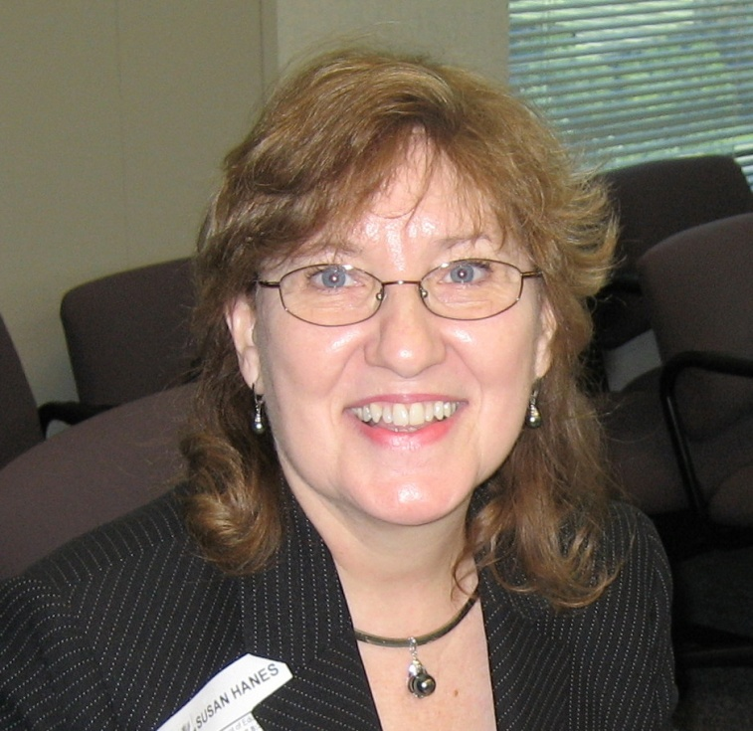
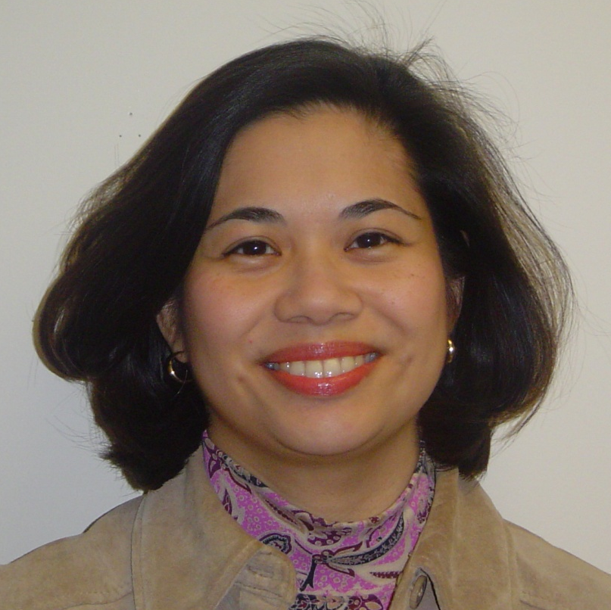
NNSSIL Co-coordinators
Susan Hanes
Technical Advisor, Center on Innovation and Improvement
Nina de las Alas
Senior Program Associate, Council of Chief State School Officers
Notes:
4

Slide 5
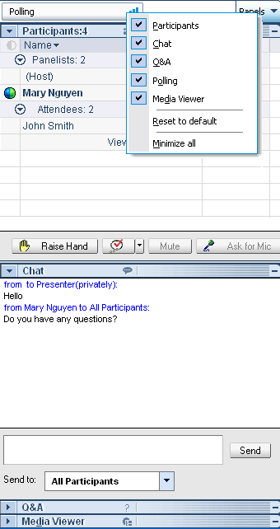
WebEx Panels & Features
Polling
Participants
Raise/lower hand
Chat
Q&A
Notes:
5

Slide 6
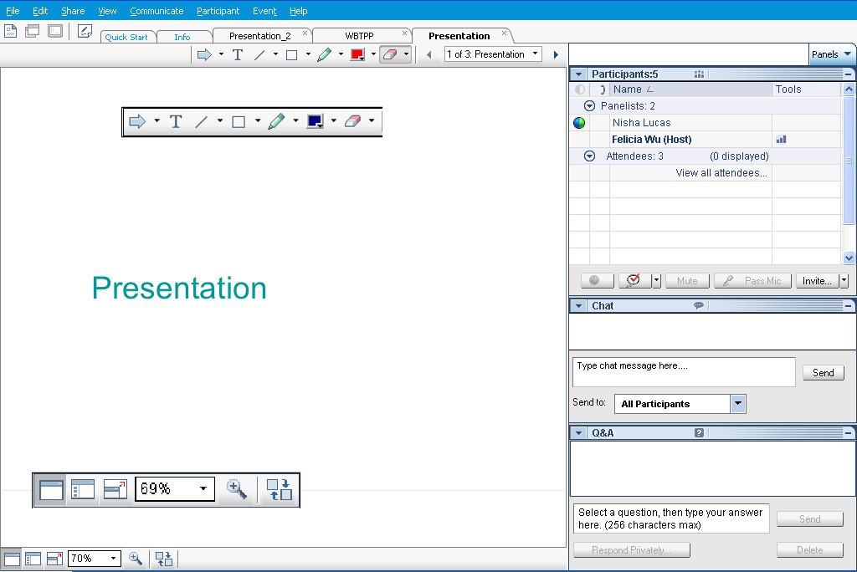
Webex Panels & Features
Presentations
Visual magnification
Audio volume (manual control through your phone or if using VOIP through computer’s audio controls . If you still cannot hear, please send Nina a chat message) or contact WebEx Tech Support (866-229-3239).
Notes:
6

Slide 7
National Network of State School Improvement Leaders (NNSSIL)
Vision
Network of state leaders engaged in developing an evidence-based body of knowledge that can lead to accelerating sustainable school, district and state improvement to raise educational results for all learners.
Mission
To provide collegial support among state leaders of school improvement to build, utilize and disseminate a robust body of knowledge of professional practices leading to systemic educational change.

Slide 8
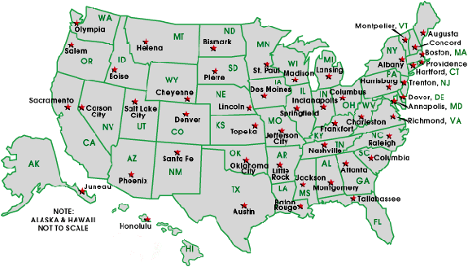
National Network of State School Improvement Leaders (NNSSIL)
Membership
50+ SEAs and territories
16 Regional Comprehensive
Centers (RCCs) & 5 Content
Centers
Advisory Group – Design Team
Subgroup of state reps., sub-dir.-level RCC
staffers, US ED, and NNSSIL co-coordinators
Administrative Partners
Center on Innovation & Improvement
Council of Chief State School Officers
More information: http://www.centerii.org/leaders

Slide 9
Training Models Geared for Rapid Improvement Initiatives
Purpose
Present Louisiana’s and Chicago’s turnaround training models. Each presentation will
  Provide a brief overview and context
  Describe the components of each model/program, including costs, selection & recruitment (LA), phases of implementation (CPS), performance metrics
  Discuss lessons learned and sustainability efforts
Address questions from participants

Slide 10
Poll Results
Question 1: Using the polling tool, indicate if
Your state or local agency has a turnaround training program or model in place
Your state or local agency has plans to design a turnaround training program or model starting in SY2010-11
Your state or local agency does NOT have any immediate plans for a turnaround training program or model
Not Applicable (not a state or local agency)
Question 2: Using the polling tool, indicate if you are a
Local state agency (i.e., school district)
State education agency
Regional comprehensive center, national content center or other technical assistance provider

Slide 11
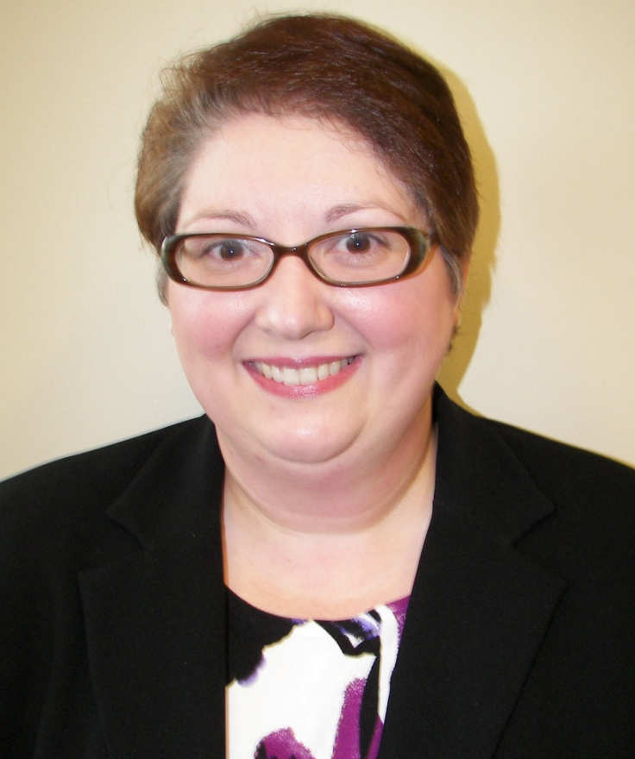
Louisiana Department of Education
Sheila Guidry
Project Administrator
Louisiana School Turnaround Specialist Program

Slide 12
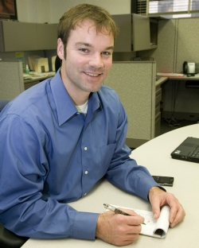
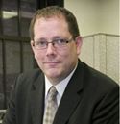
Chicago Public Schools
Donald Fraynd
Turnaround Officer
Office of School Turnaround
Randel Josserand
Director
Office of School Development
Notes:
12

Slide 13
Video
http://www.youtube.com/watch?v=VC2cfdtjmRU
(If you are having difficulty viewing the video, open another window and enter the address above. Switch to the WebEx window when done.)

Slide 14
Q & A and Discussion

Slide 15
Q & A and Discussion
Please note that your phone line is muted upon entry and will remain muted (see red x in front of your name)
To get speakers’ attention, please use the “Raise Hand” button in the Participants Panel. We will un-mute then.
You can also post your questions or comments on the Q & A Panel.
Notes:
15

Slide 16
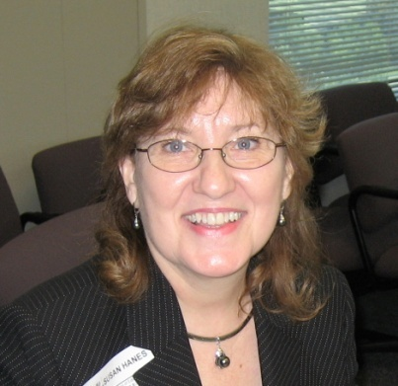

Panelists
Susan Hanes
NNSSIL Co-Coordinator/
Moderator
Sheila Guidry
Louisiana DOE
Randel Joserrand
Chicago Public Schools
Donald Fraynd
Chicago Public Schools
Notes:
16

Slide 17
For More Information www.centerii.org/leaders
Link to this webinar’s recording, slides and resources mentioned during the presentations
NNSSIL Community Site
School Improvement Grants Resources
LEA SIG Survey – http://www.centerii.org/CenterIIPublic/SIG_Survey.aspx
Feedback
Follow-up questions? Send to Susan Hanes, shanes@centerii.org

Slide 18

Thank you to our featured presenters and thank you all for participating in today’s webinar!
Notes:
18

